Slide 1
SQL: Joins and Unions

Slide 2
Table of Contents
Joins
Inner/Natural Join
Left Outer Join
Right Outer Join
Full Outer Join
Self Join
Unions
Union
Union All

Slide 3
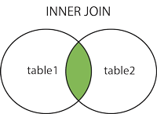
Inner/Natural Join
Returns matching records in both tables
SELECT column_name(s) FROM table1 INNER JOIN table2 ON table1.column_name = table2.column_name;

Slide 4
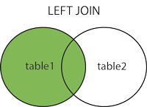
Left Outer Join
Matching records from right table and all records from left table
NULL is returned from right table when there is no match
SELECT column_name(s) FROM table1 LEFT JOIN table2 ON table1.column_name = table2.column_name;

Slide 5
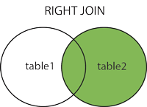
Right Outer Join
Matching records from left table and all records from right table
NULL is returned from left table when there is no match
SELECT column_name(s) FROM table1 RIGHT JOIN table2 ON table1.column_name = table2.column_name;

Slide 6
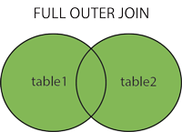
Full Outer Join
Returns all records if a match is found on either side
NULL is returned from both tables where they do not match
SELECT column_name(s) FROM table1 FULL OUTER JOIN table2 ON table1.column_name =table2.column_name;

Slide 7
Self Join
Joins a table with itself
Useful for running counts and totals
SELECT column_name(s) FROM table1 T1, table1 T2 WHERE condition;

Slide 8
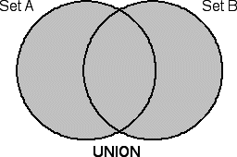
Union
Combine two select queries
Same number of columns and order
Similar data types
Distinct by default
Optional WHERE clause
SELECT column_name(s) FROM table1 UNION SELECT column_name(s) FROM table2;

Slide 9
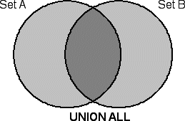
Union All
Combine two select queries
Same number of columns and order
Similar data types
Allows duplicate values
Optional WHERE clause
SELECT column_name(s) FROM table1 UNION ALL SELECT column_name(s) FROM table2;

Slide 10
Demo
Sample queries
Union All vs Full Outer Join?

